Slide 1
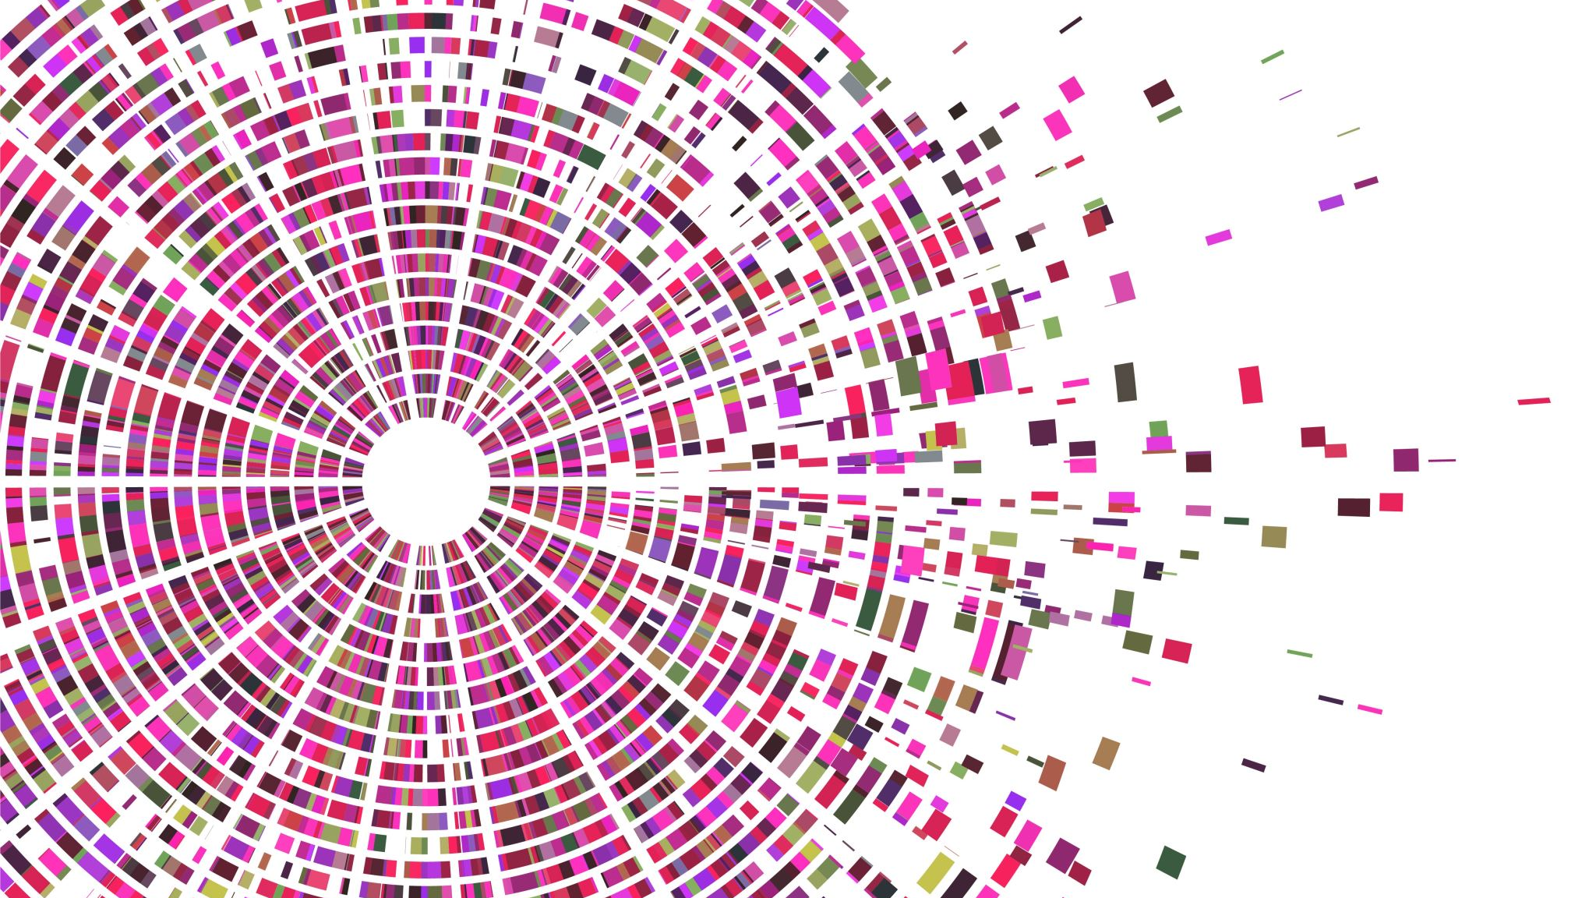
Fermi Paradox
Vidvuds Beldavs
ZURD 19.04.2021.

Slide 2
Topics
Fermi parakdoks
Ievads šajā tēmā – Recenzija «“Where are they?”: SETI and modern science fiction»
Milan Cirkovic Grāmata – «The Great Silence»
Tālāks skats
.

Slide 3
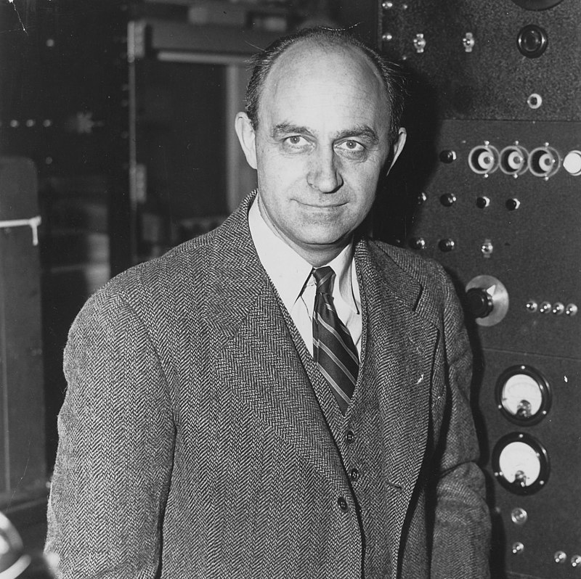
Fermi paradox
1951. Fermi lunch with Edward Teller, Herbert York and Emil Konopinski reportedly said "But where is everybody?“
.

Slide 4
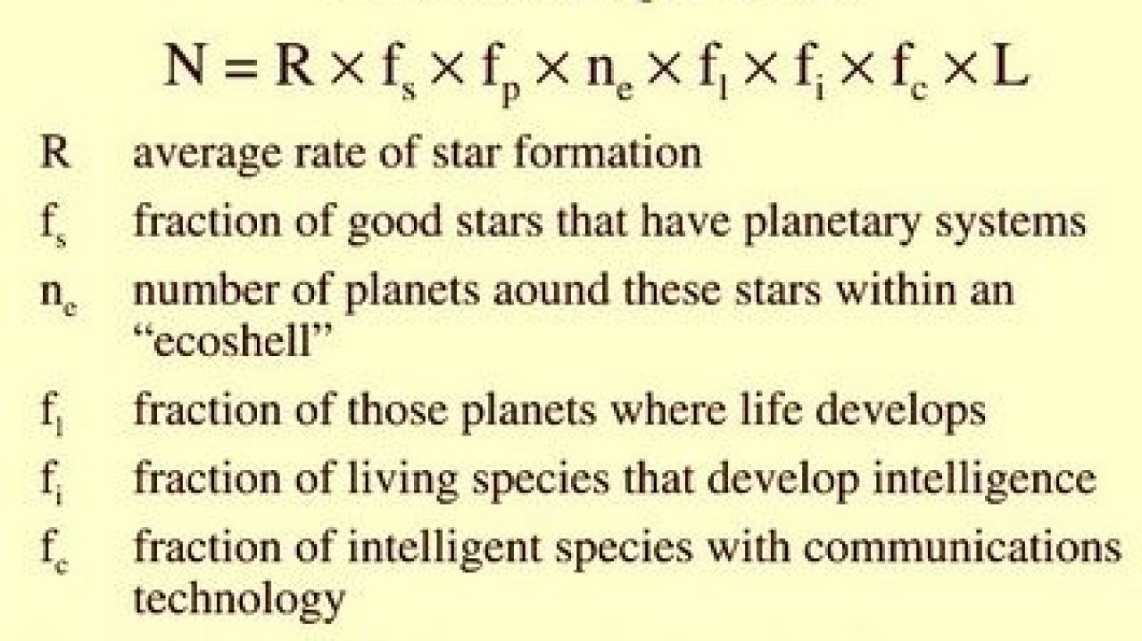
Drake equation

Slide 5
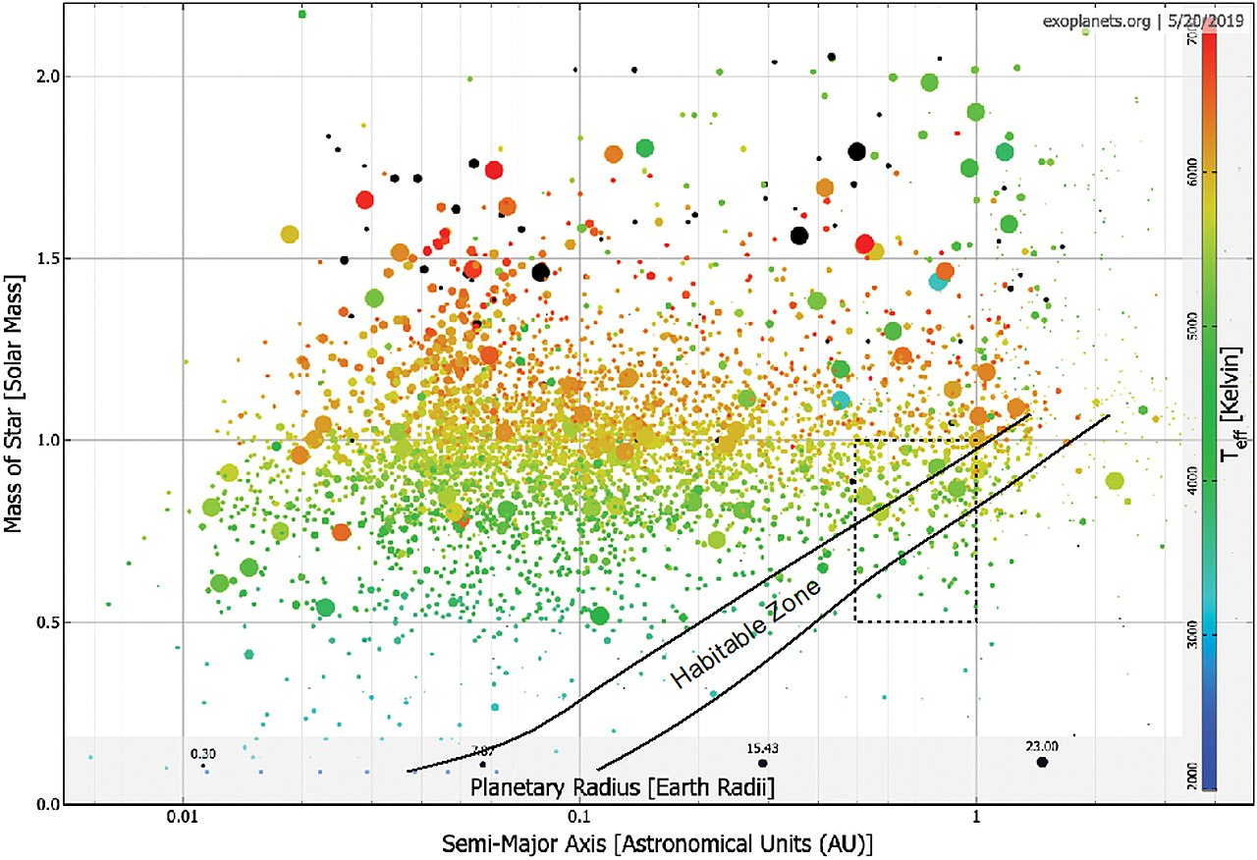
Known 4500 exoplanets

Slide 6
300 million Habitable planets in Milky Way
"The Occurrence of Rocky Habitable Zone Planets Around Solar-Like Stars from Kepler Data" https://arxiv.org/abs/2010.14812
"We present occurrence rates for rocky planets in the habitable zones (HZ) of main-sequence dwarf stars based on the Kepler DR25 planet candidate catalog and Gaia-based stellar properties. We provide the first analysis in terms of star-dependent instellation flux, which allows us to track HZ planets. We define η⊕ as the HZ occurrence of planets with radius between 0.5 and 1.5 R⊕ orbiting stars with effective temperatures between 4800 K and 6300 K. We find that η⊕ for the conservative HZ is between 0.37+0.48−0.21 (errors reflect 68\% credible intervals) and 0.60+0.90−0.36 planets per star, while the optimistic HZ occurrence is between 0.58+0.73−0.33 and 0.88+1.28−0.51 planets per star. These bounds reflect two extreme assumptions about the extrapolation of completeness beyond orbital periods where DR25 completeness data are available. The large uncertainties are due to the small number of detected small HZ planets. We find similar occurrence rates using both a Poisson likelihood Bayesian analysis and Approximate Bayesian Computation. Our results are corrected for catalog completeness and reliability. Both completeness and the planet occurrence rate are dependent on stellar effective temperature. We also present occurrence rates for various stellar populations and planet size ranges. We estimate with 95% confidence that, on average, the nearest HZ planet around G and K dwarfs is about 6 pc away, and there are about 4 HZ rocky planets around G and K dwarfs within 10 pc of the Sun."

Slide 7

“Where are they?”: SETI and modern science fiction
V. Beldavs, Review of Cixin Liu, “The Three-Body problem” , The Space Review: “Where are they?”: SETI and modern science fiction

Slide 8

English & Chinese

Slide 9


Slide 10
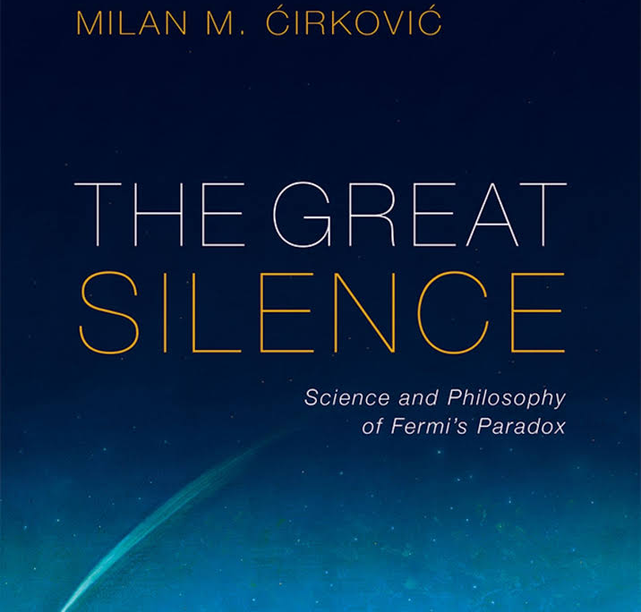
Milan Čircovič asked that I review his book
Analyzes over 75 attempt at resolving the paradox and classifies them.
The book is dense and well-written. Comparable in many ways to Goedel, Escher, Bach by Douglas Hofstadter

Slide 11
Astrophysics, astrobiology postbiological evolution
A catalog of solutions, without comparative analysis.
http://alpha.sinp.msu.ru/~panov/webb_s_if_the_universe_is_teeming_with_aliens_where_is_every.pdf

Slide 12
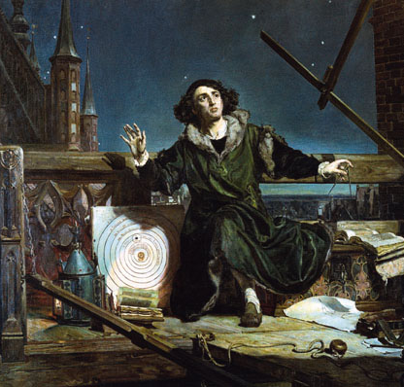
Copernicanism
The Earth is not the center of the Solar System and the Solar System is not the center of the universe.

Slide 13

The Noosphere Species Theory
( www.Werbos.com/religions.htm)
Like noosphere theory deChardin/Verdansky but:
  Origin in evolution of noospheres in cosmos is necessary for logical completeness as a scientific theory
  Fits how our solar/earth noosphere “is a baby” (Terry not Gaia)

Slide 14

Thank you! Paldies!
Vidvuds Beldavs
Riga Photonics Centre
www.rigaphotonicscentre.org
vidbeldavs@fotonika-lv.eu

