Slide 1
Human by Night, Beast by Day: The Werewolf Archetype in Latvian Culture
Ieva Alberton MA, Dramatherapy

Slide 2
How it all began
‘How to Be a Latvian’: a self-exploratory performance exploring cultural stereotypes and intergenerational trauma.
The werewolf—vilkatis in Latvian— unearths the complex boundaries between the civilised self and the ‘inner beast’ (Bourgault du Coudray, 2006). It also reveals themes of defiance, justice, and empowerment (Nitsun, 2015).
In the context of dramatherapy, the werewolf facilitates transformation, integration, and a deeper self-understanding, here explored throughout folklore (Kursīte, 1996) and history (Zemzaris,1939).

Slide 3
Awakened by Night
The poem speaks of a fated thirst: an archetypal pull between what is socially visible and what lies hidden, revealing a deep impulse to reconcile fragmented aspects of the self.
With striking imagery, Latvian poet Knuts Skujenieks evokes the figure of the vilkatis—though not explicitly—in the line: “dienu cilvēks, nakti pelēks vilks” (“a man by day, a grey wolf by night”) (Skujenieks, 1986, p.73).

Slide 4
The Origins of the Myth
In the Epic of Gilgamesh, the goddess Ishtar transforms her shepherd lover into a wolf (Dalley, 1998).
In Lycia, Zeus was worshipped in wolf form, reflecting archaic rituals steeped in cannibalism and human sacrifice (Beresford, 2013).
Apollo and his sister Artemis, too, bore lupine associations. Their mother, Leto, became a she-wolf to protect her children—an image echoed in werewolf lore, where female transformations evoke themes of power, protection, birth, and rebirth (Gimbutas and Dexter, 2001; Priest, 2015; Šuvcāne, 2003).
The tale of Romulus and Remus, suckled by a she-wolf, further cements the wolf as a dual symbol of ferocity and nurture, central to the mythic foundations of Rome.

Slide 5
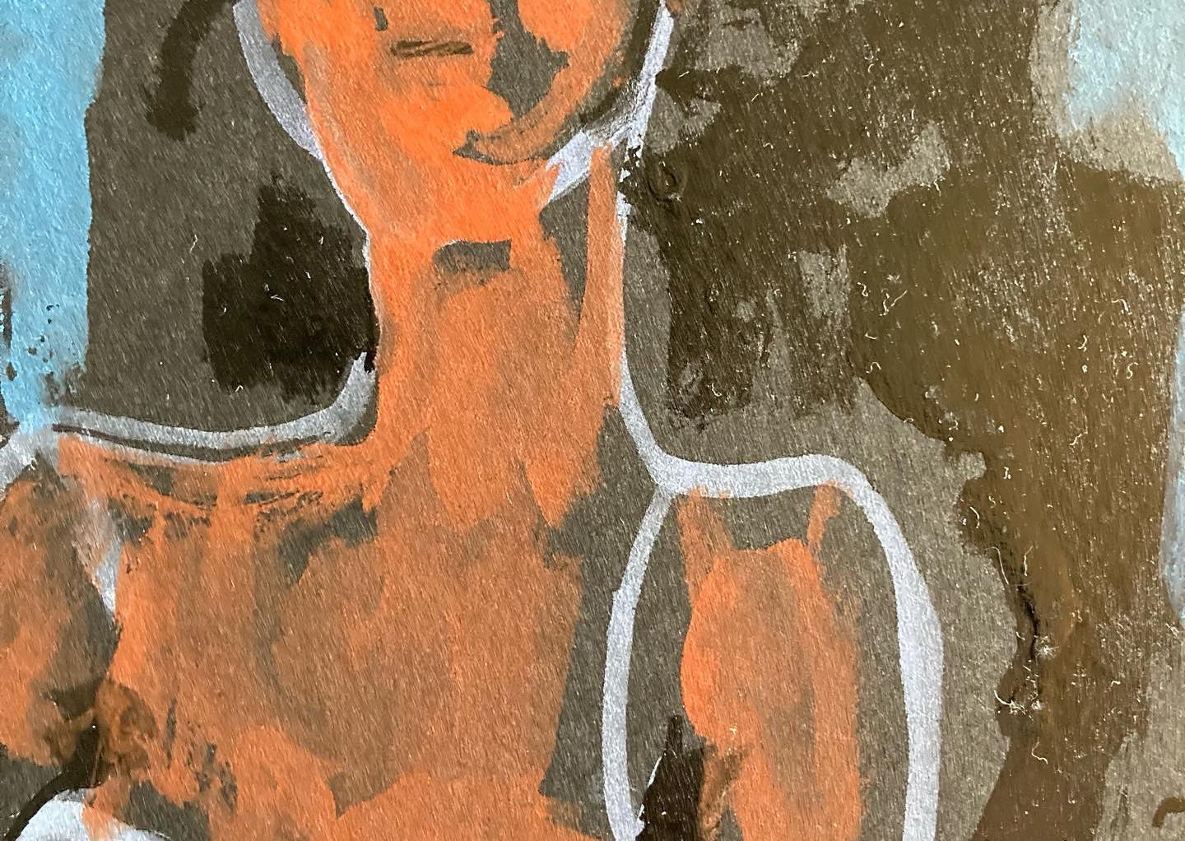
Homo Sacer; the Hidden Meaning of the Werewolf
Italian philosopher Giorgio Agamben describes Homo Sacer as a figure excluded from both legal and religious order — a person who can be killed but not sacrificed, stripped of rights and reduced to bare life (Agamben, 2007).
Agamben (p. 64) connects this figure to the werewolf:
“What had to remain in the collective unconscious as a monstrous hybrid of human and animal, divided between the forest and the city — the werewolf — is, therefore, in its origin the figure of the man who has been banned from the city”
The werewolf symbolizes the Homo Sacer: criminal, outcast, beast — someone exiled to the margins of society, caught between nature and culture, living in a state of exception where normal laws no longer apply (Agamben, 2007) .

Slide 6
Werewolves in the North
The ancient Greek historian Herodotus wrote about the Neuri, a northern people believed to transform into wolves once a year (Baring-Gould, 1973). By the early modern period, werewolves had become a defining feature in descriptions of Livonia (present-day Latvia and Estonia), which gained notoriety as Europe's ‘Eldorado’ of werewolves (Straubergs, 1939).
Friedrich Menius, a professor of history at the University of Dorpat (Tartu), noted:
"The outrageous lycanthropy of the Livonians is so widespread that even those who cannot tell the difference between their right and left hands are usually familiar with it” (Donecker, 2012).

Slide 7
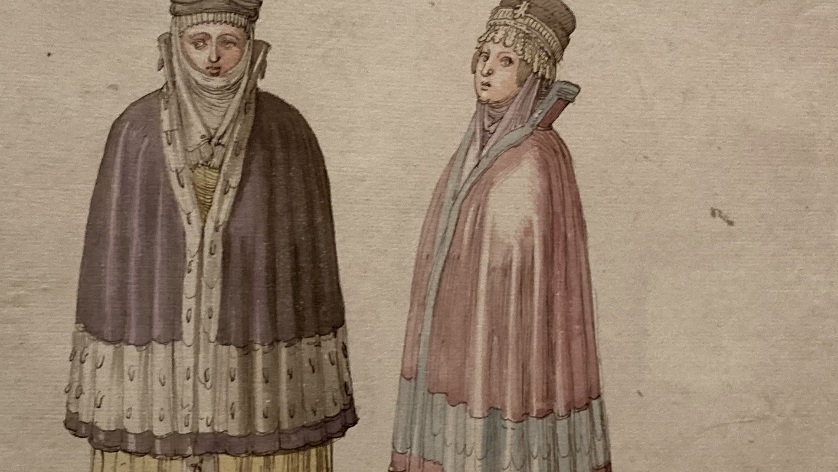
Once upon a time in Livonia
Livonia was marked by strict social stratification along ethnic lines. The nobility and urban elites were mainly Germans, descendants of crusaders and Hanseatic merchants who had colonized the land during the Middle Ages (Abers et al., 1939, p.328; Gimbutas and Dexter, 2001; Levans and Zanders, 2021).
The serfs - the indigenous Estonians and Latvians, endured crippling physical labour, corporal punishment, family separation, and poverty. The Baltic German pastor August W. Hupel (1737-1819) witnessed:
“Peasants here are not as expensive as Negroes in the American colonies” (Lietiņa Ray, 2003).
Lycanthropy reports have been observed to surge during times of war and unrest, when fascination with grotesque monsters—symbols of discord—tended to grow (Donecker 2012; Jiaxin, 2022).

Slide 8
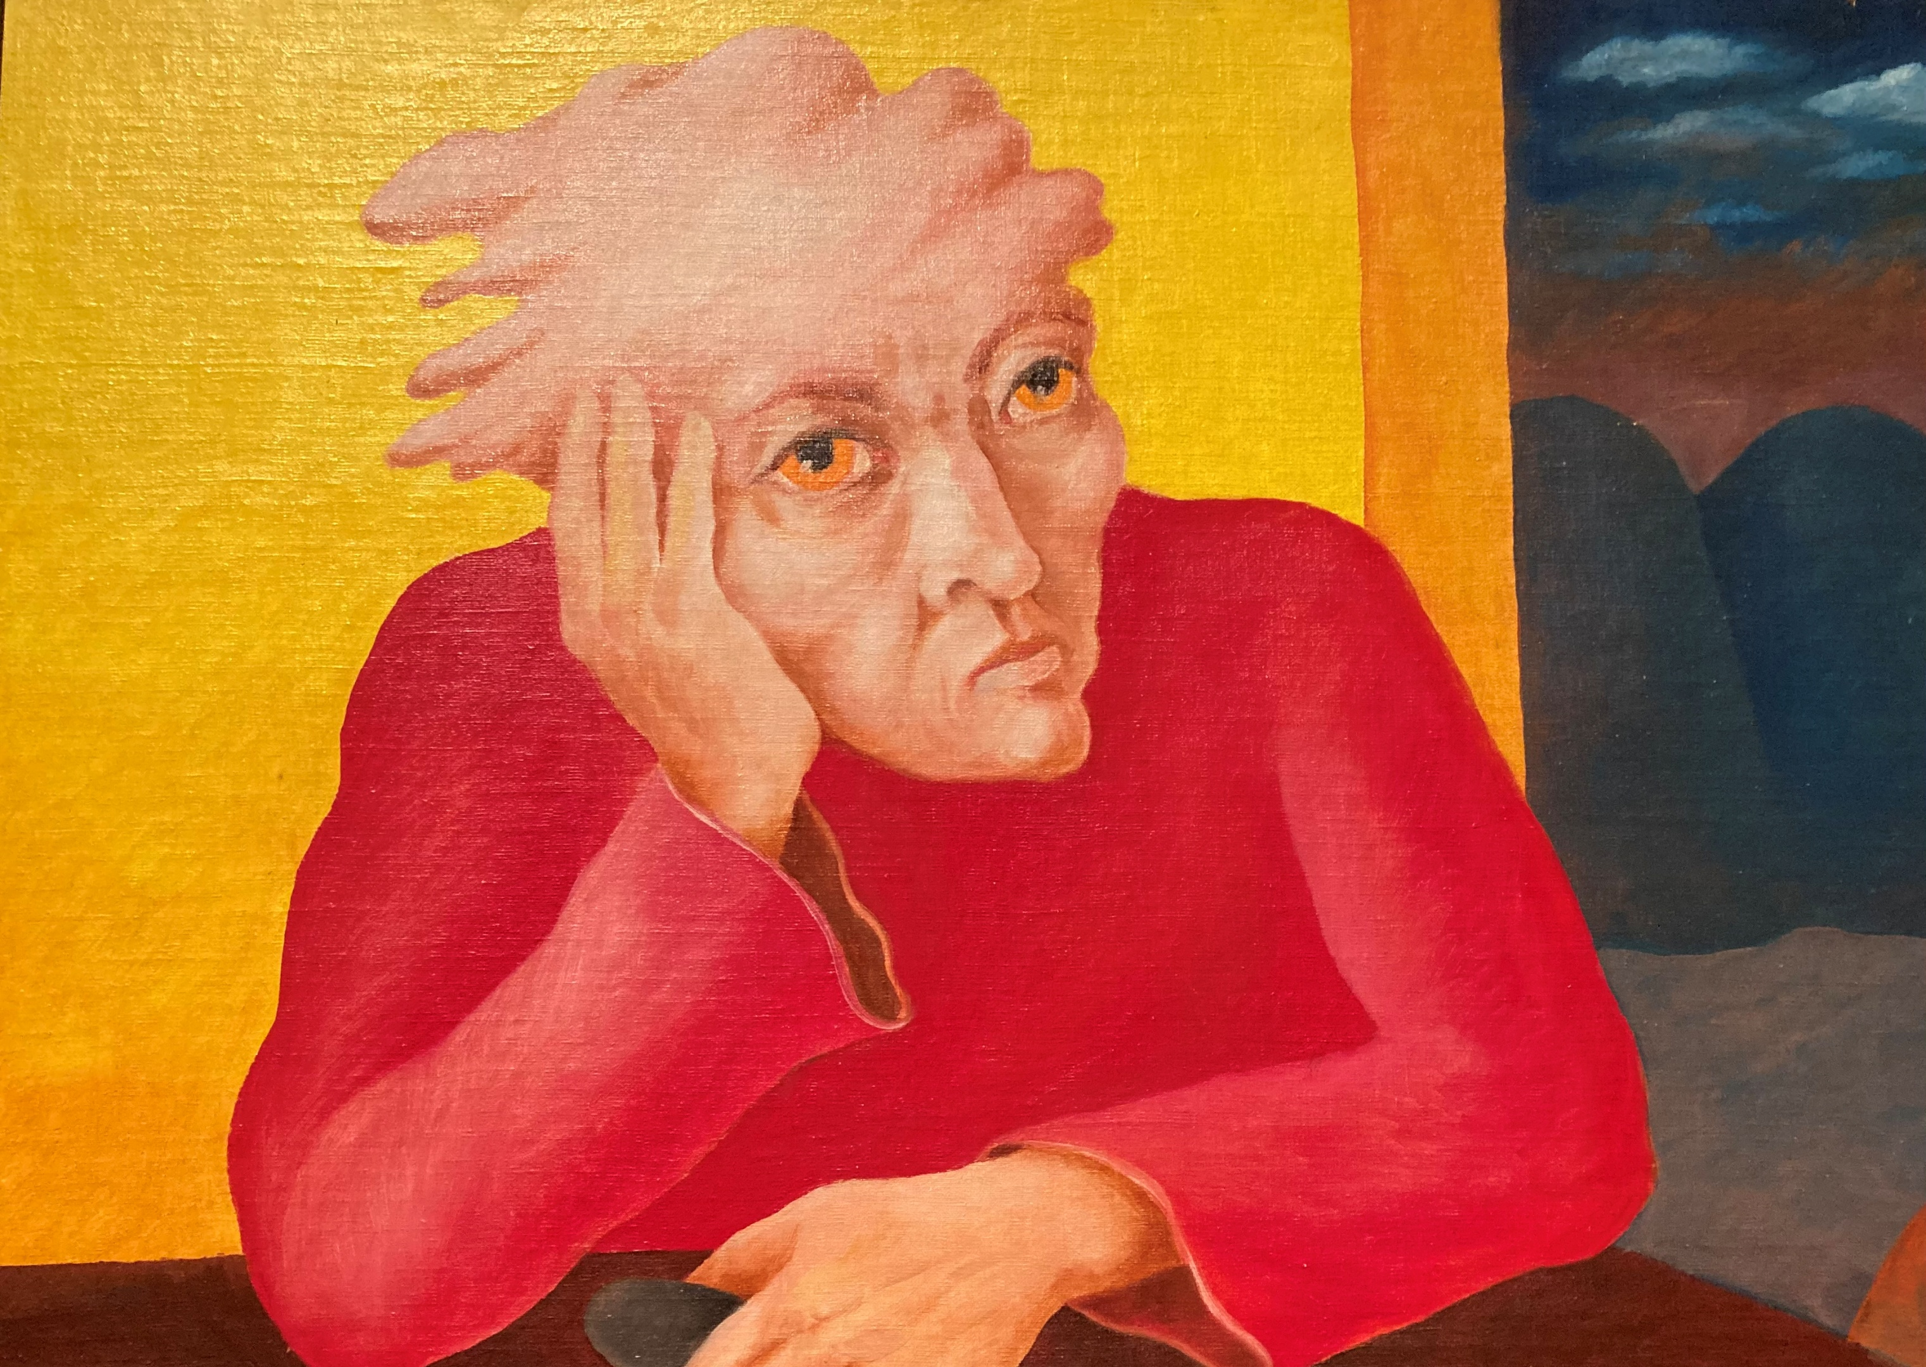
1691: Proud to be a Werewolf
In 1691, in the Livonian town of Wenden (Cēsis), 86-year-old peasant Old Thiess was accused of a grave transgression—being a werewolf. Rather than deny it, he proudly confessed (Jiaxin, 2022; Zemzaris, 1939).
His case remains a striking example of the resilience of local beliefs amid cultural oppression and erasure (Ginzburg, 2017; Lūsiņa, 2025).
As recorded in a court transcript:
“he showed himself truly obstinate and remained insistent that all he had done was no sin against God” (Ginzburg and Lincoln, 2020).

Slide 9
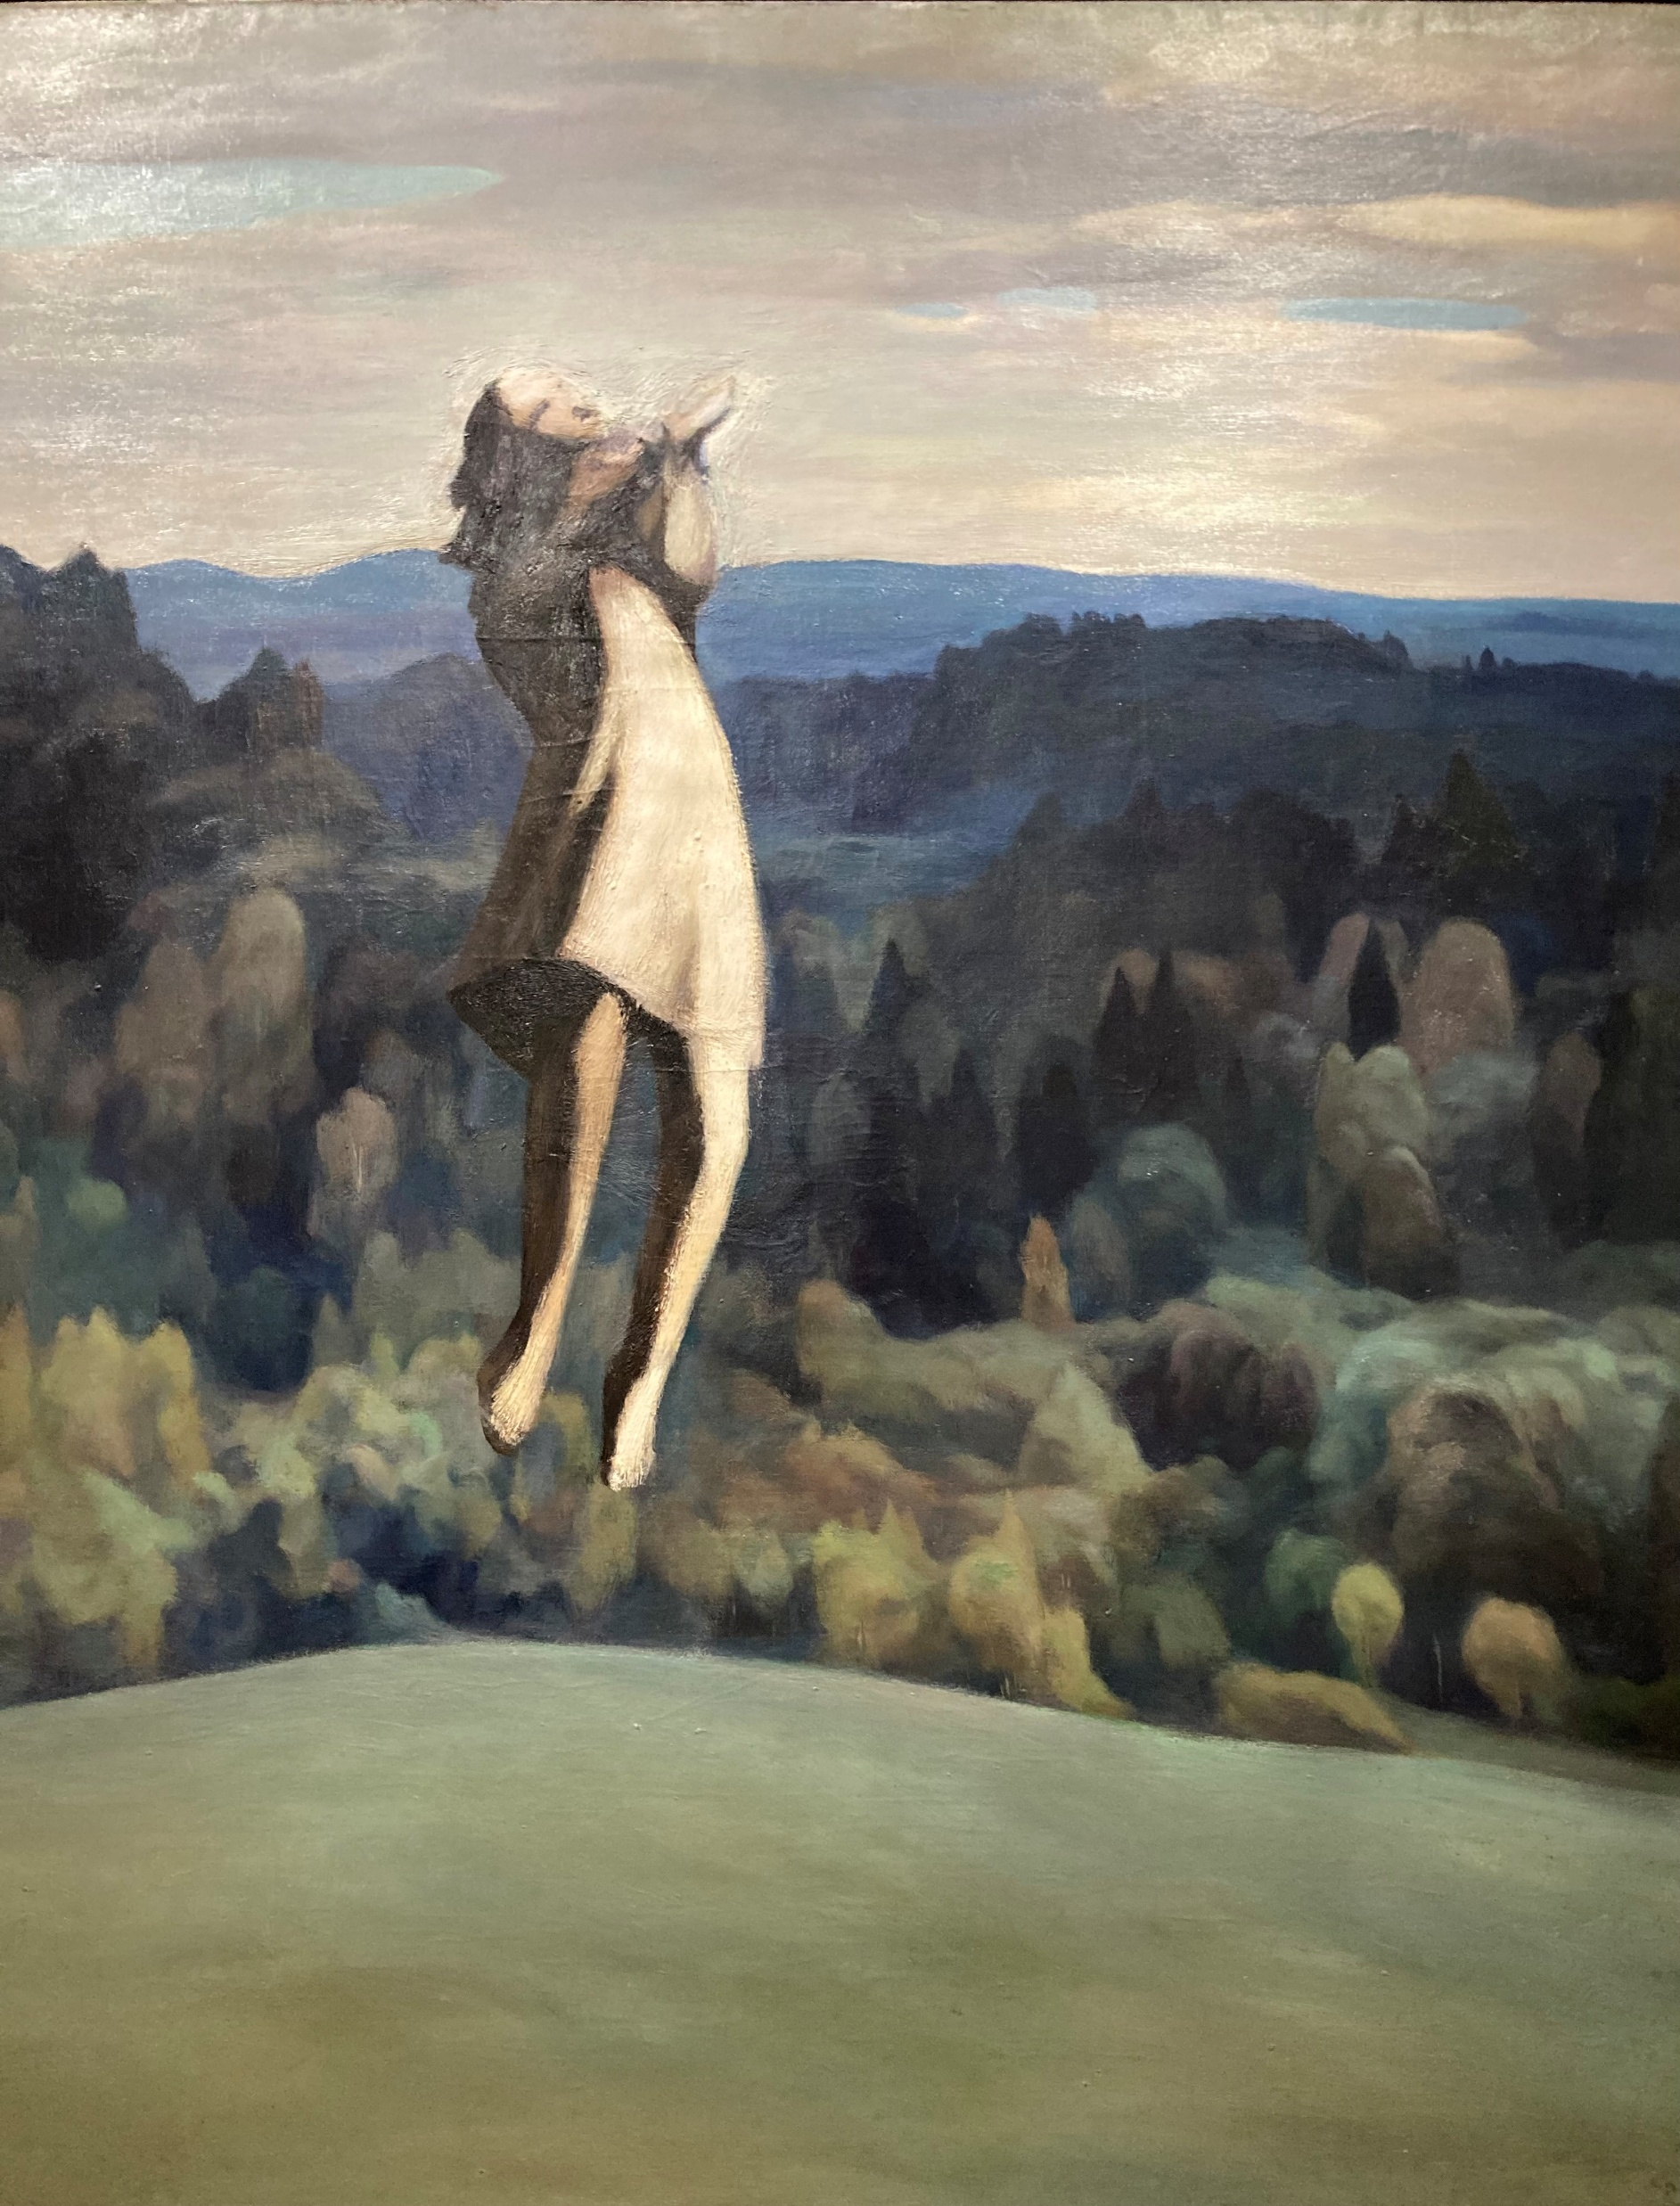
Werewolf is real, present, and remembered
In Latvian folklore, wolves are revered as sacred messengers and guardians of divine law, sometimes known as God’s Hounds (Reidzāne, 2019; Stauga, 2011). They embody masculine sexual energy and, alongside the goat, represent the cyclical interplay of light and darkness (Dainuskapis, 2025).
Transformation into a werewolf is described in folk instructions as requiring the removal of clothing and crawling through a hollow or arched tree or its roots. Kursīte (1996) links such “curved” forms with chaos, interpreting the act as symbolic death and initiation.
Werewolves frequently appear in folktales as true events, naming the individual, witnesses, location, and time. Some even mention the werewolf’s grave, weighed with stones to prevent its return (Šuvcāne, 2003).

Slide 10
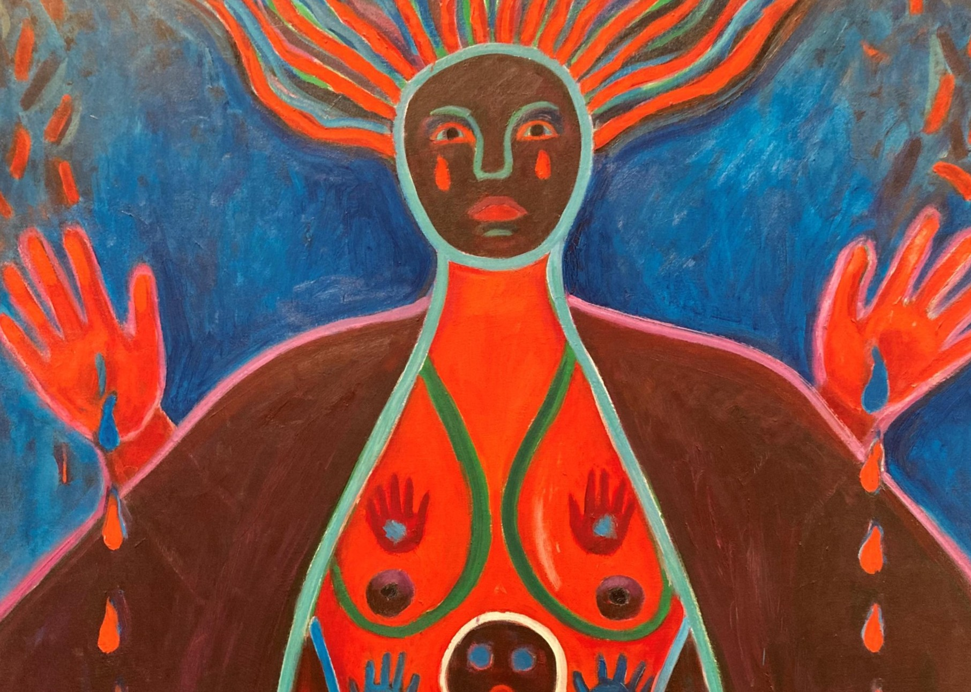
Manifestation of Shadow
Latvian Lutheran pastor Ralfs Kokins’ autobiographical ‘Werewolf Tales from Courland’ (Kurzemes vilkaču nostāsti, Kokins, 2007) weaves together memory, urban legend, and theological reflection (Simsone, 2018).
In this enchanted landscape, werewolves, though feared, are accepted as part of the natural order. They embody both personal and collective unconscious forces. While fearsome in form, they do not harm without cause; their attacks serve to protect or punish wrongdoing. As oracles, encounters with vilkatis become epiphanies—moments of sudden clarity that offer deeper insight into life and the world.

Slide 11
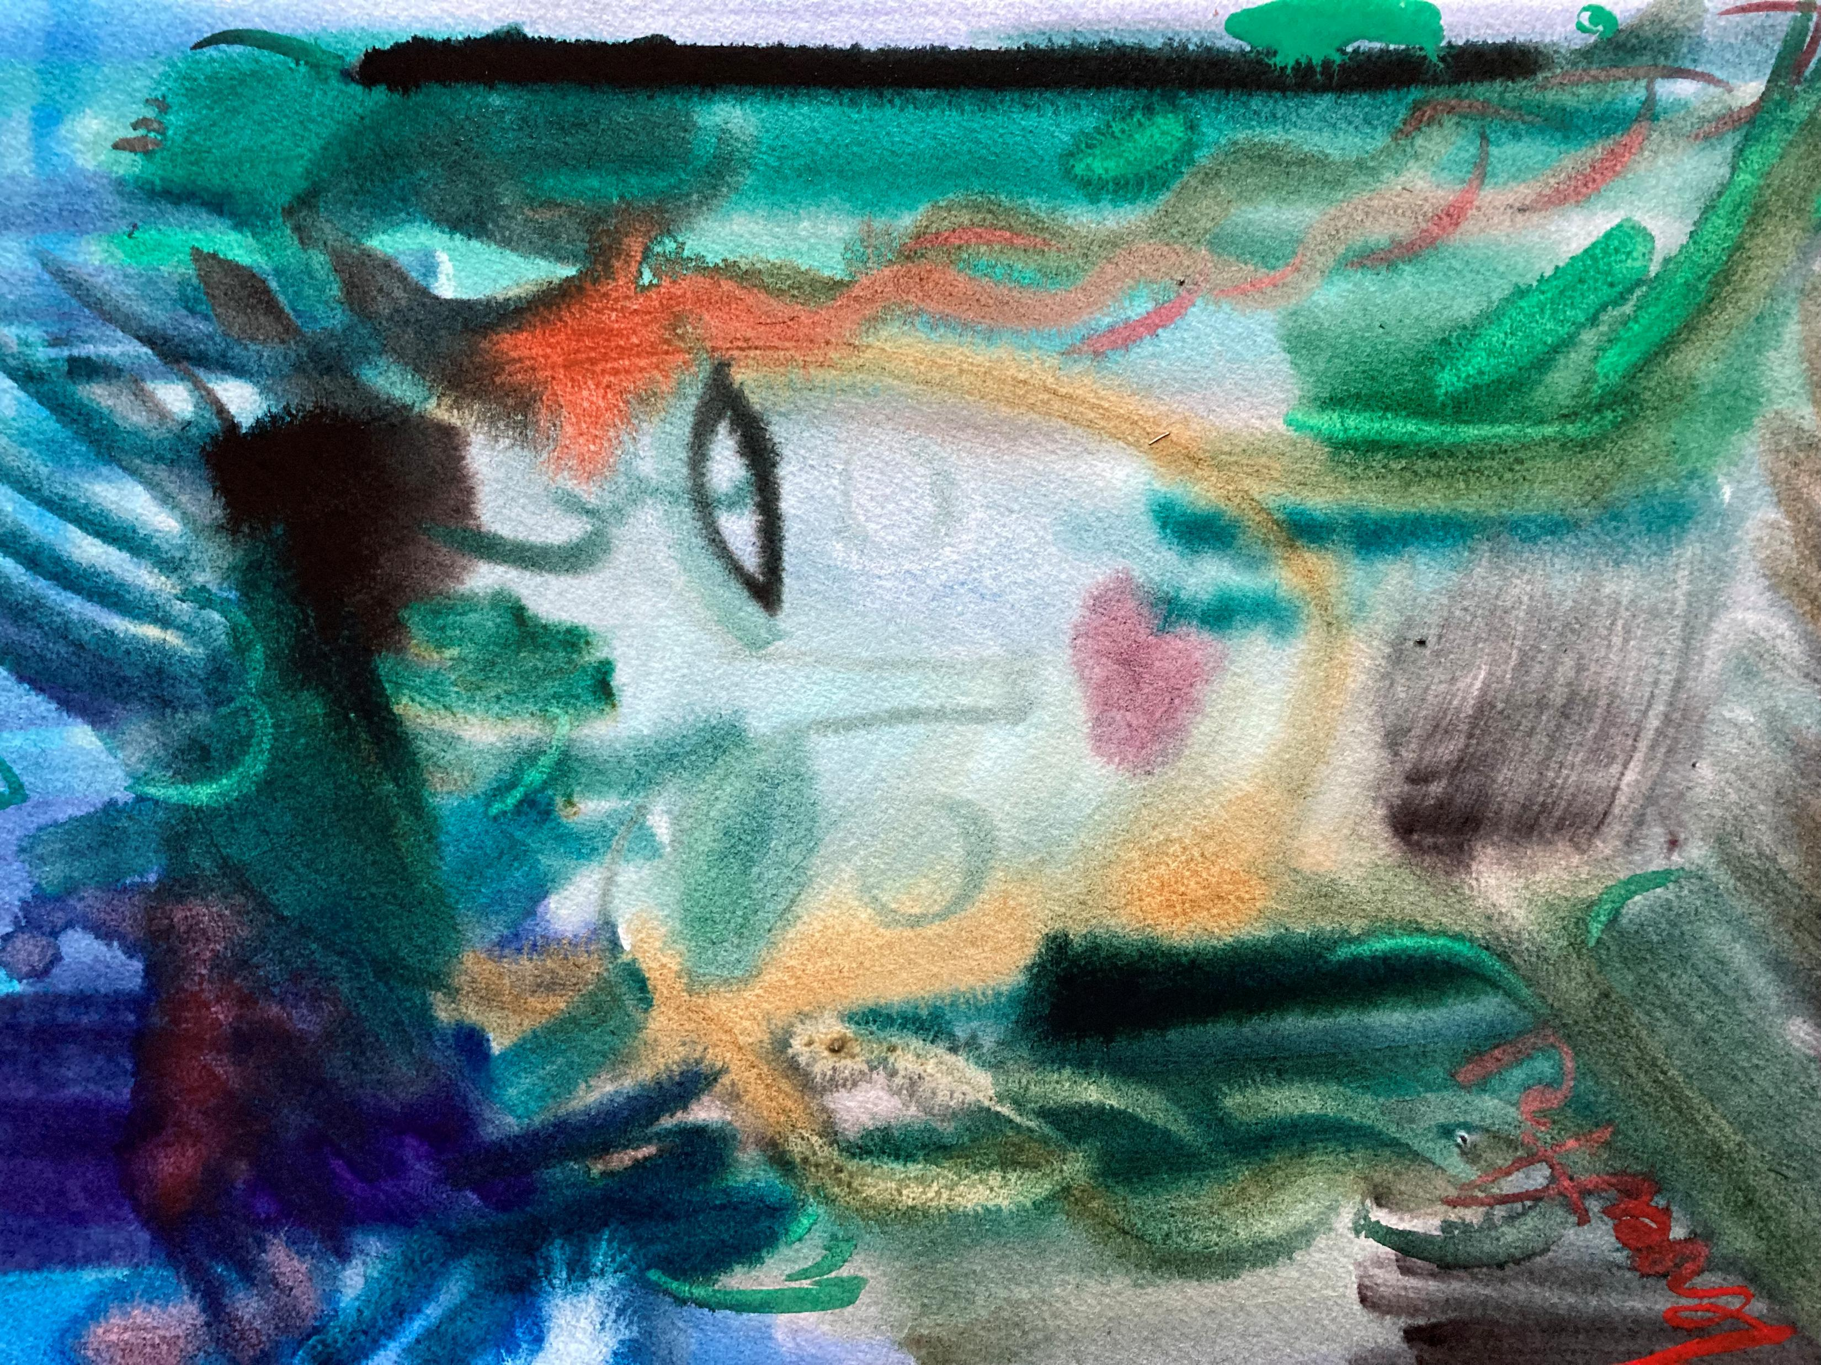
Women Werewolves as Agents of Change
The female werewolf is an emblematic figure in Latvian culture. Two notable plays named ‘Vilkate’—one by Aina Neboisa (Zagarins, 2025), another written by the Estonian playwright August Kitzberg (Straumanis,1979) but frequently staged in Latvia—and the novel ‘The Heiress of Vilkači’ (Leimane, 2012), which has also been adapted into a film, reflect the enduring fascination with this figure in Latvian cultural imagination.
The main characters are strong, free-spirited women (Gimbutas and Dexter, 2001). They are seen as outsiders—suspected of having “bad blood” (Chollet, 2022). What else could explain their refusal to submit to the patriarchal and superstitious norms of rural society?
Although two stories end in tragedy, with the she-werewolves being subdued (Zagarins, 2025) or killed (Strautmanis, 1979), their resistance has a profound impact. Through their death, the community is compelled to reckon with its fear and cruelty, transforming its moral compass.
In this light, the women werewolves (Priest, 2015) become sacrificial figures—not to uphold the status quo, but to ignite a more just and humane order.

Slide 12
The ‘Dramatic Reality’ of the Werewolf Stories
Werewolf narratives engage the audience in a state of dramatic reality—an imaginative space where symbolic transformation becomes possible (Jones, 1991; Pendzik, 1988, 2006; Pitruzzella, 2006). Through physical enactment or imaginative participation, both storyteller and listener cross into an alternative reality (Ginzburg, Tedeschi & Tedeschi, 2013; Schubert, 2020).
The werewolf—versipelle in Latin, oborot in Slavic traditions—acts as a liminal figure marking this threshold. Transformative spaces (Pendzik, 2003; Pitruzzella, 2006) emerge in forests, deserted roads, or dreams, often during the night or altered states when boundaries blur (Ginzburg, 2017; Kokins, 2007; Šmits, 1940; Šuvcāne, 2003). Passage through these symbolic landscapes (Pendzik, 1988) enables psychological change, revealing deeper truths, new perspectives, and inner knowledge (Kokins, 2007).

Slide 13
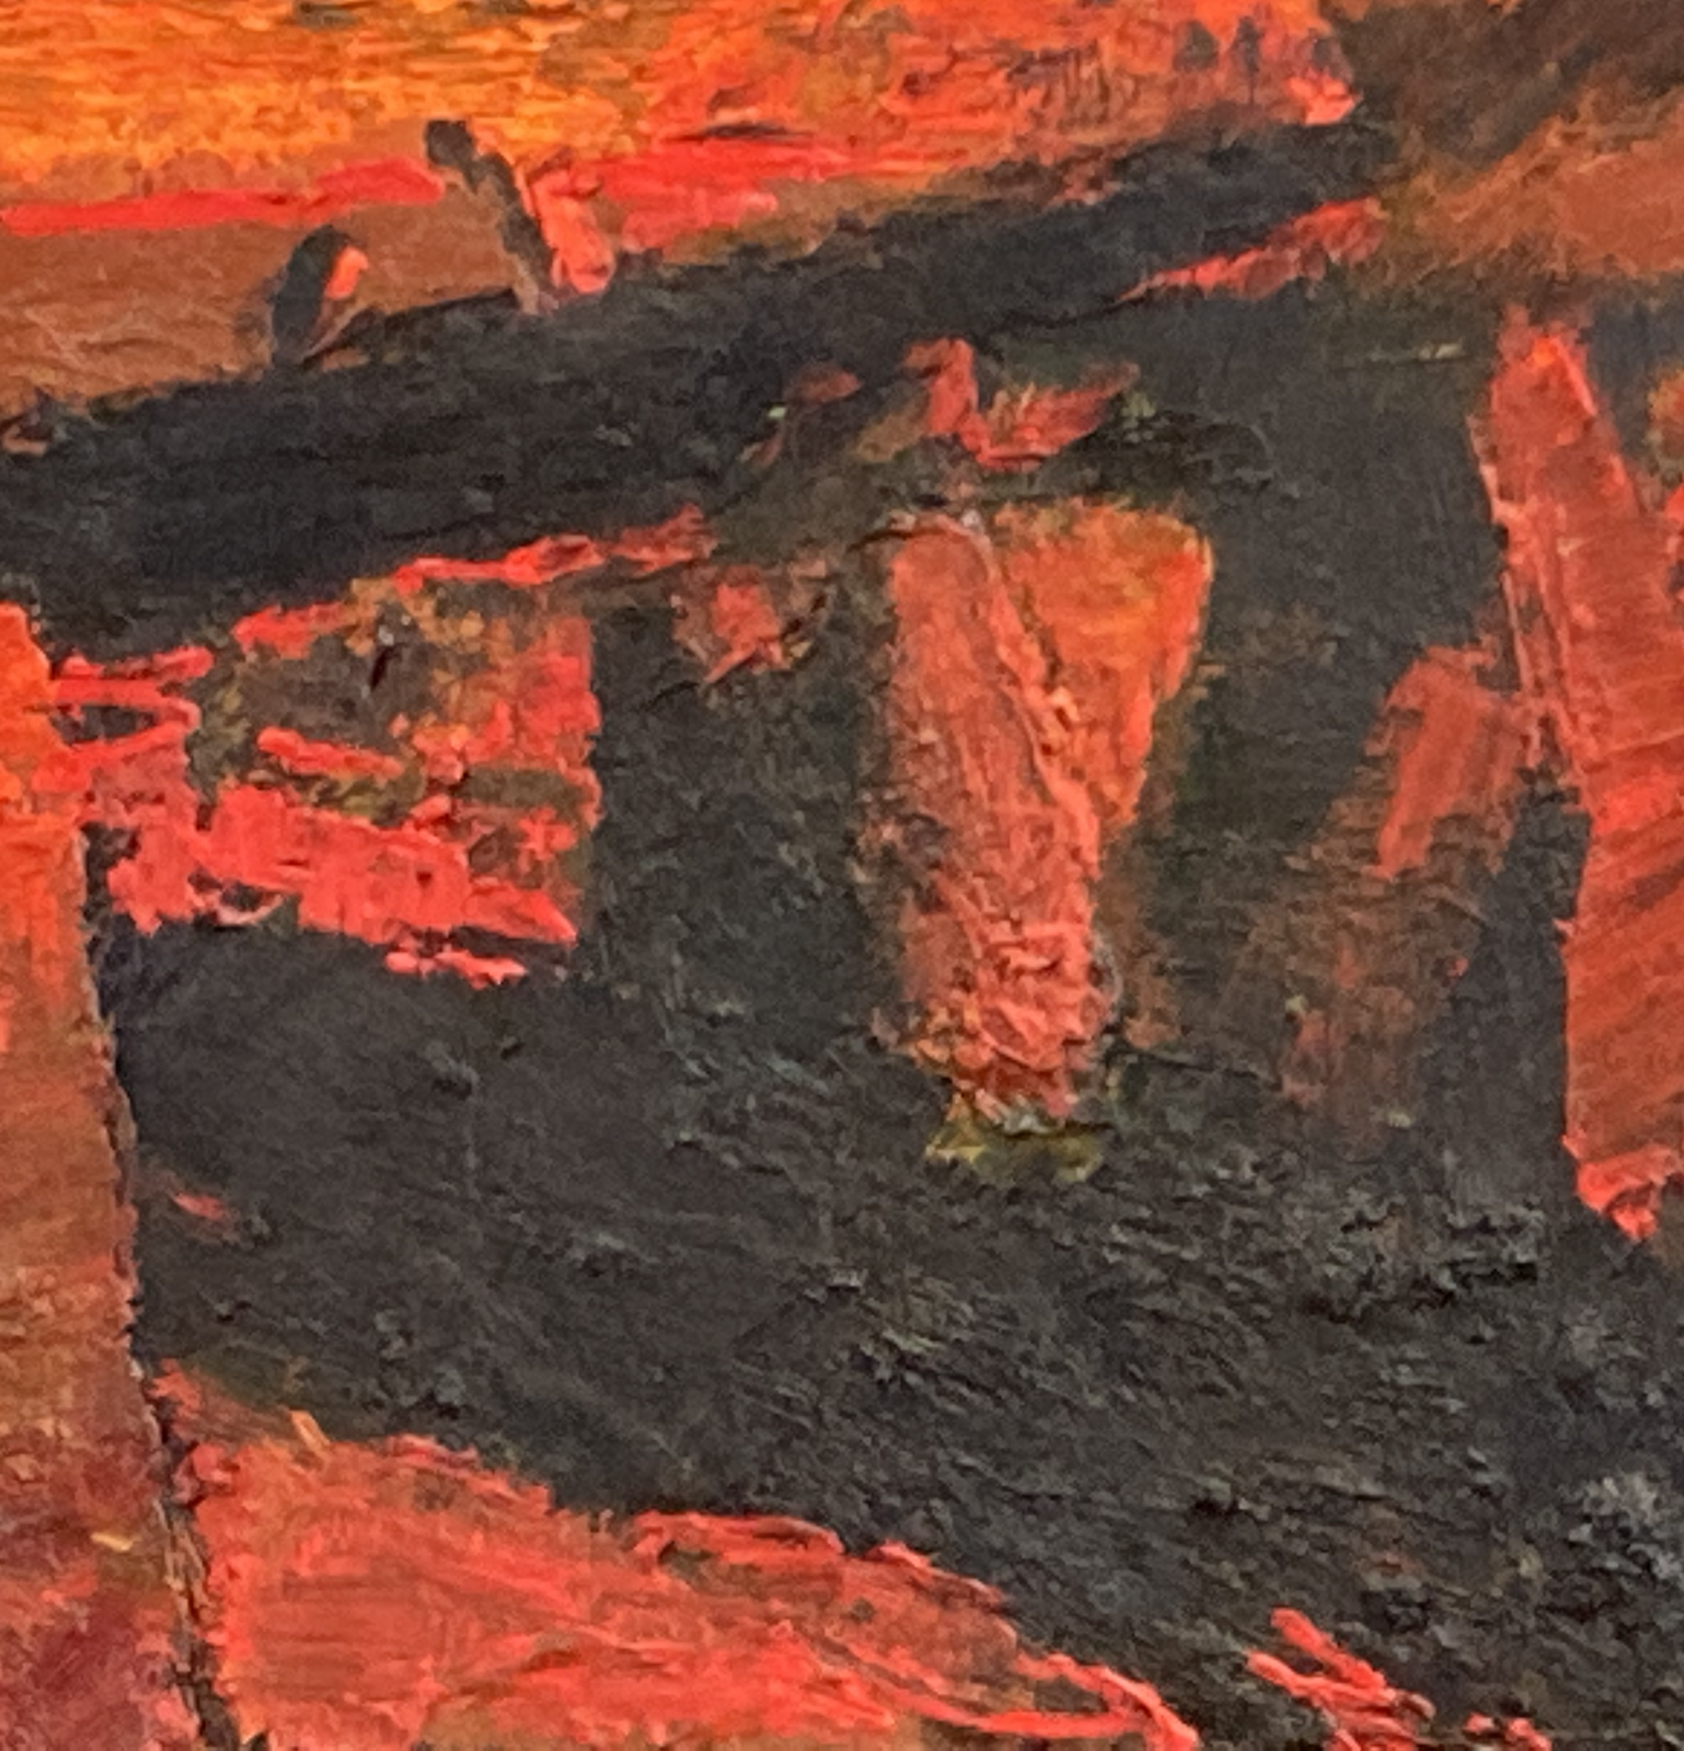
Werewolves in Modern Times
The figure of vilkatis is embedded in Latvian culture, seen in folk groups like Vilki (Wolves) and Vilkači (Werewolves), the rock band Dzelzs Vilks (Iron Wolf), the bikers' brotherhood Dieva Suņi (God’s Hounds). Notably, the Latvian army’s special forces coat of arms features a man in a wolf’s pelt, an image rooted in prehistoric Europe (Gimbutas and Dexter, 2001).
Historically, Livonia was seen as a land of monsters (Donecker, 2012). Latvia’s modern history echoes with the figure of the werewolf—Homo Sacer, excluded from political and moral order (Agamben, 2007). During World War II, Latvia, occupied by both the Soviets and Nazis (Institute of the History of Latvia, 2005), saw forests become refuges for Jews, Red Partisans, Forest Brothers (mežabrāļi), and others fleeing persecution (Rigas Laiks, 2017).
These events still scar the Latvian collective memory, and their processing remains a work in progress. As a Latvian, I look forward to confronting our collective shadow, intergenerational trauma (Mdwaba, 2024) and working toward reconciliation.

Slide 14
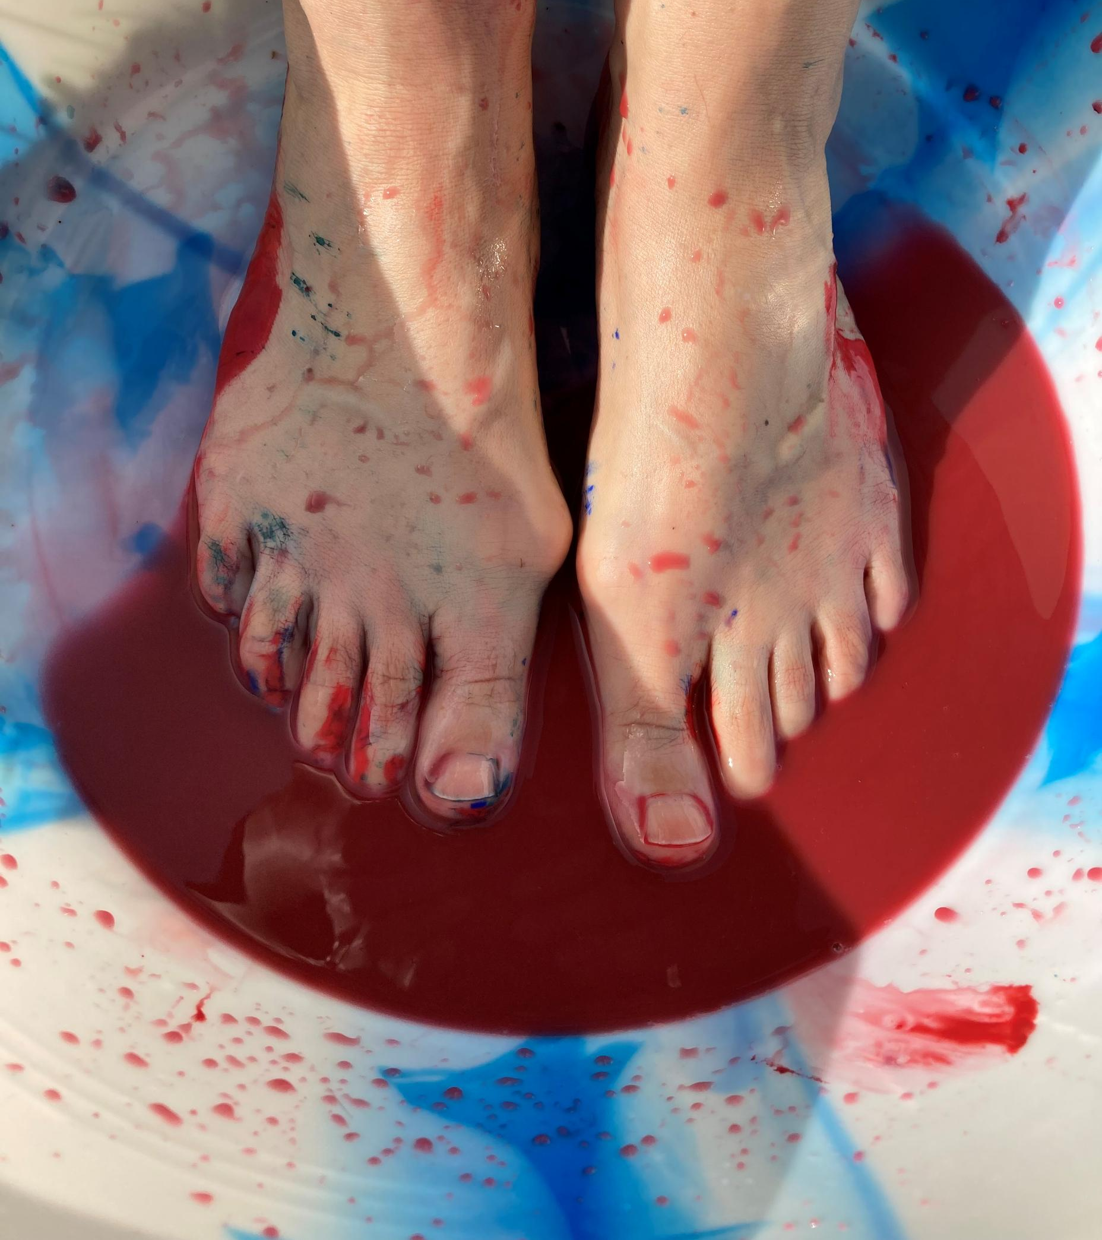
Dramatherapy in the face of Vita Nuda
Dramatherapists often work with people in crisis or transition—refugees, prisoners (Levanas, 2016), hospital patients (Metzger, 2013), the elderly—those whose dignity and rights have been stripped, reduced to bare life (vita nuda, Agamben 2007).
Paradoxically, the werewolf archetype offers a way through. It can reconnect individuals with the full range of their human experience, giving voice to feelings, beliefs, and desires that have been silenced (Campbell, 1990).
Like the Trickster archetype (Jung, 2003), the Werewolf is neither good nor evil, but a coping mechanism that helps people survive and process the unbearable (Sconduto, 2014). In Dramatherapy, the werewolf can serve as a creative, symbolic tool to explore what society forbids, allowing hidden parts to be seen, expressed, and transformed (Rebillot, 2001).

Slide 15
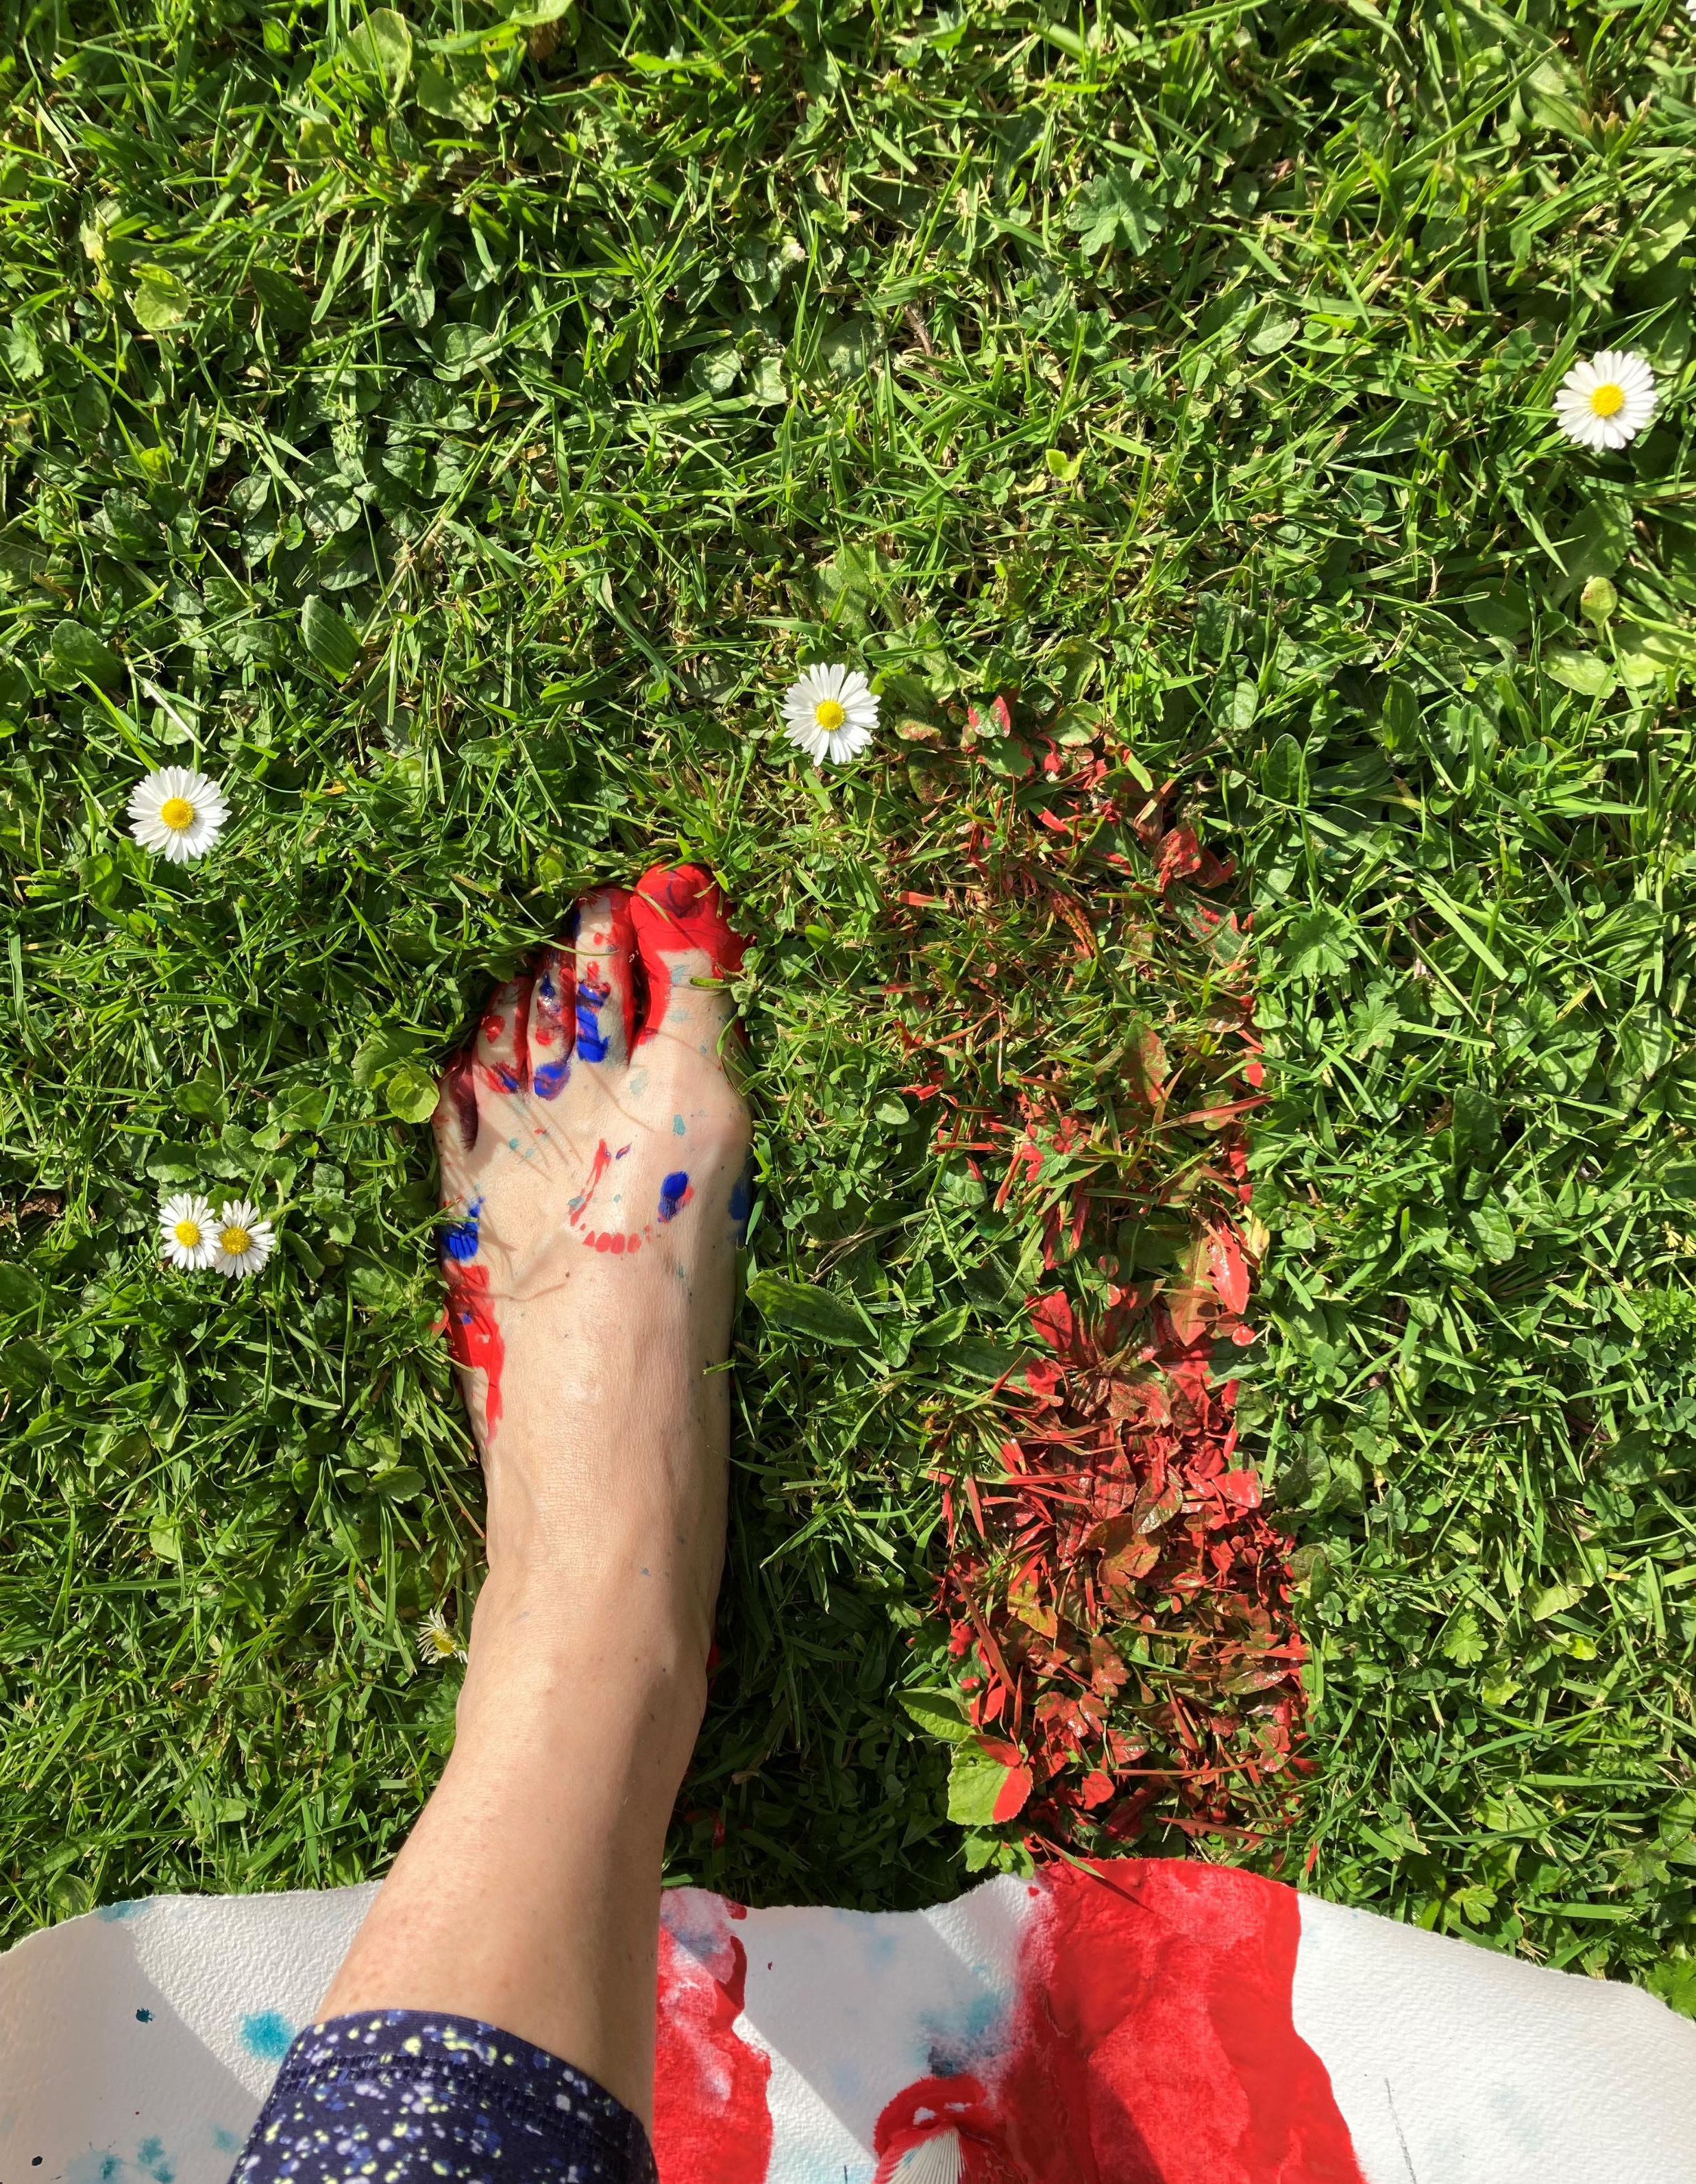
Conclusion
The werewolf is a powerful, universal metaphor. Unlike the vilified figure in popular culture, the Latvian vilkatis invites reflection on what is hidden or suppressed, both culturally and personally. In Latvian cultural memory, the werewolf symbolizes otherness, resilience, and transformation (Kokins, 2007; Zagarins, 2025).
In dramatherapy, this archetype offers a creative space to embody the exiled self, heal intergenerational wounds, and engage with the shadow through empathy and imagination.

Slide 16
References
Abers, Adamovičs, Alksne, Altements, Bērziņš, Bīlmanis, Bračs, Dunsdorfs, Grīnbergs, Karlsons, Malvess, Spekke, Stepermanis, Tentelis and Zeids (1939). Latviešu vēsturnieku veltījums profesoram Viperam. A Gulbis, p.328.
Agamben, G. (2007). Homo Sacer. [online] Available at: https://www.thing.net/~rdom/ucsd/biopolitics/HomoSacer.pdf.
Aleksander Pluskowski (2019). Ecologies of crusading, colonization, and Religious Conversion in the Medieval Baltic : Terra Sacra II. Turnhout, Belgium: Brepols.
Baring-Gould, S. (1973). The Book of Were-Wolves; Being an Account of a Terrible Superstition. New York: Causeway Books.
Beresford, M. (2013). The White Devil. Reaktion Books.
Bourgault du Coudray, C. (2006). The Curse of the Werewolf. Bloomsbury Publishing.
Campbell, B. (1990). Metaphor in Dramatherapy. Dramatherapy, 13(1), pp.1–6. doi:https://doi.org/10.1080/02630672.1990.9689786.
Chollet, M. (2022). In Defence of Witches : Why Women Are Still on Trial. London: Picador.
Dalley, S. (1998). Myths from Mesopotamia. Oxford University Press, USA.
Donecker, S. (2012). The Werewolves of Livonia: Preternature: Critical and Historical Studies on the Preternatural, 1(2), pp.289–322. doi:https://doi.org/10.5325/preternature.1.2.0289.
Fiske, J. (1873). Myths and Myth-makers. James R. Osgod and Company.
Ginzburg, C. (2017). Conjunctive Anomalies: a Reflection on Werewolves. Revista de Estudios Sociales, 60(60), pp.110–118. doi:https://doi.org/10.7440/res60.2017.09.
Ginzburg, C. and Lincoln, B. (2020). Old Thiess, a Livonian Werewolf a Classic Case in Comparative Perspective. [online] Available at: https://press.uchicago.edu/sites/thiess/old_thiess_transcript.pdf [Accessed 27 Mar. 2025].
Inese Lūsiņa (2025). Balss, kas mums liek domāt. Koncertstāsta Vecais Tīss. Vilkatis recenzija. [online] Diena.lv. Available at: https://www.diena.lv/raksts/kd/recenzijas/balss-kas-mums-liek-domat.-koncertstasta-_vecais-tiss.-vilkatis_-recenzija-14312889 [Accessed 15 Mar. 2025].
Institute of the History of Latvia (2005). The Hidden and Forbidden History of Latvia under Soviet and Nazi Occupations 1940-1991. [online] Available at: https://transitionaljusticedata.org/public_files/reportTCID151.pdf.
Jiaxin, L. (2022). Livonian Werewolves: Assessing Their Historical Significance through the Case of Old Thiess. Review of European Studies, 14(4), p.61. doi:https://doi.org/10.5539/res.v14n4p61.
Jones, P. (1991). Dramatherapy: Five Core Processes. Dramatherapy, 14(1), pp.8–15. doi:https://doi.org/10.1080/02630672.1991.9689804.
Jung, C.G. (2003). Four Archetypes : Mother, Rebirth, Spirit, Trickster. London: Routledge.
Kokins, R. (2007). Kurzemes vilkaču nostāsti. Zvaigzne ABC, p.152.
Kursīte, J. (1996). Latviešu folklora mītu spogulī. Zinātne, p.444.
Latviešu folkloras krātuve (2025). Meklēšana : Dainu Skapis. Latvju dainas, tautasdziesmas, dziesmas. [online] Dainuskapis.lv. Available at: https://dainuskapis.lv/meklet/vilks [Accessed 14 Apr. 2025].
Leimane, I. (2012). Vilkaču Mantiniece. Zvaigzne ABC, p.224.

Slide 17
References continued
Levanas, D. (2016). The Institutionalized body: an Investigation into the Use of Drama Therapy on a Forensic Psychiatric Unit. [online] Academia.edu. Available at: https://www.academia.edu/20859779/The_institutionalized_body_An_investigation_into_the_use_of_drama_therapy_on_a_forensic_psychiatric_unit [Accessed 29 Mar. 2025].
Levāns, A. and Zanders, M. (2021). Aizmirstā Livonija. Aminori.
Lietiņa Ray, M. (2003). Recovering the Voice of the oppressed: Master, Slave, and Serf in the Baltic Provinces. Journal of Baltic Studies, 34(1), pp.1–21. doi:https://doi.org/10.1080/01629770200000231.
Marija Alseikaite Gimbutas and Miriam Robbins Dexter (2001). The Living Goddesses. Berkeley: University of California Press, , Cop.
Mdwaba, N. (2024). A ‘curious and non-defensive Approach’ to Working with Intergenerational Trauma in Dramatherapy. Dramatherapy, 45(2), pp.217–234. doi:https://doi.org/10.1386/dj_00020_1.
Nitsun, M. (2015). The anti-group : Destructive Forces in the Group and Their Creative Potential. Hove U.K.: Routledge.
Pendzik, S. (1988). Drama Therapy as a Form of Modern Shamanism. Journal of Transpersonal Psychology, 20(1).
Pendzik, S. (2003). Six Keys for Assessment in Drama Therapy. The Arts in Psychotherapy, 30(2), pp.91–99. doi:https://doi.org/10.1016/s0197-4556(03)00024-8.
Pendzik, S. (2006). On Dramatic Reality and Its Therapeutic Function in Drama Therapy. The Arts in Psychotherapy, 33(4), pp.271–280.
Pitruzzella, S. (2006). Dramatic Identity: the Challenge of Complexity. Dramatherapy, 28(3), pp.21–25. doi:https://doi.org/10.1080/02630672.2006-2007.9689703.
Priest, H. (2015). She-wolf. Manchester University Press.
Rebillot, P. (2001). The Healing Power of Myth. Dramatherapy, 23(2), pp.18–21. doi:https://doi.org/10.1080/02630672.2001.9689580.
Reidzāne, B. (2019). Latviešu tautasdziesmu semantika. Vilka tēls ‘Latvju dainās’. Rīga: Zinātne, p.784.
Rigas Laiks (2017). Eju tumšā mežā kā mājās - Rīgas Laiks. [online] Rigaslaiks.lv. Available at: https://www.rigaslaiks.lv/zurnals/sarunas/eju-tumsa-meza-ka-majas-18802 [Accessed 11 Apr. 2025].
Schubert, M. (2020). Dramatherapy and Fairytale: Entering the Fantastic Reality. Dramatherapy, 41(1), pp.25–36. doi:https://doi.org/10.1177/0263067221996923.
Sconduto, L.A. (2014). Metamorphoses of the Werewolf. McFarland.
Simsone, B. (2018). Mācītāja Ralfa Kokina ‘Kurzemes vilkaču nostāsti’. Literatūra un Reliģija, [online] pp.128–134. doi:https://doi.org/10.22364/lursug.09.
Skujenieks, K. (1986). iesien baltā lakatiņā. Rīga: Liesma, p.183.
Šmits, P. (1940). Latviešu tautas ticējumi. Latviešu folkloras krātuve.
Spekke, A. (1995). Latvieši un Livonija 16. gs. Rīga: Zinātne.
Stauga, J. (2011). Jolanta Stauga Dzīvnieki latviešu folklorā: mītiski maģiskais aspekts (pēc latviešu tautasdziesmu un mūsdienu folkloras materiāliem) . [online] Available at: https://dspace.lu.lv/dspace/bitstream/handle/7/4618/17585-Jolanta_Stauga_2010.pdf?sequence=1 [Accessed 15 Apr. 2025].
Straubergs, K. (1939). Vilkaču ideoloģija Latvijā. In: Latviešu vēsturnieku veltījums profesoram Dr. hist. Robertam Viperam. Rīga: A Gulbis. Straumanis, A. (1979). The Golden Steed. Waveland Press.
Šuvcāne, V. (2003). Lībiešu folklora. Jumava.
Zagarins (2025). JG39 Aina Neboisa. Vilkate. [online] Zagarins.net. Available at: http://www.zagarins.net/jg/jg39/JG39_Neboisa.htm [Accessed 23 Mar. 2025].
Zemzaris, T. (1939). Vilkaču prāvas Vidzemē. In: Latviešu vēsturnieku veltījums profesoram Dr. hist. Robertam Viperam. Rīga: A Gulbis.

